Slide 1
ASE Internship- GCP
Asynchronous data processing with pub-sub and cloud functions

Slide 2
Utilize Pub/Sub for scalable, event-driven communication between services.
Integrate Cloud Functions with Pub/Sub to process messages in real-time.
Implement and test an asynchronous data pipeline through a hands-on lab exercise.
Apply best practices for building robust event-driven architectures.

Slide 3
Serverless Architecture

Slide 4
Why Serverless
Fully managed infrastructure: No setup, maintenance, or patching of serverless infrastructure. Scale up and down based on traffic.
Portability with containers: Build and deploy serverless applications as containers or bring your own Open Container Initiative compliant containers to run.
Leverage integration with Google Cloud services: Integrate with AI/ML technologies from Google, such as vision, video processing, Speech-to-Text, and other APIs to build smart applications.
Notes:
https://www.websoptimization.com/blog/serverless-architecture-benefits-use-cases-examples/

Slide 5
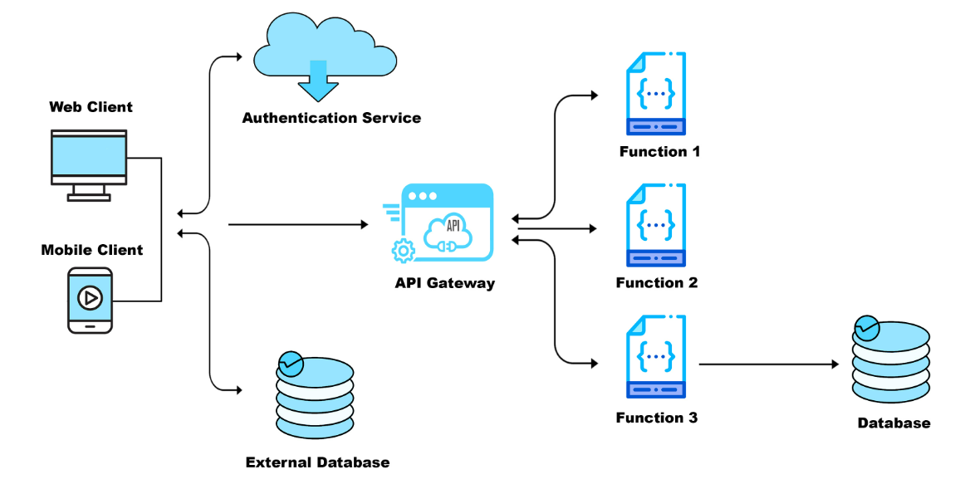
Serverless Architecture
Notes:
https://www.websoptimization.com/blog/serverless-architecture-benefits-use-cases-examples/

Slide 6
Cloud Function - Introduction

Slide 7
What are Google Cloud Functions?
Serverless execution environment
For building and connecting cloud services
Simple, single-purpose functions that are attached to events
Function is triggered when an event being watched is fired
Can be written using JavaScript, Python 3, Go, or Java runtimes

Slide 8
Introduction to Cloud Function
Event-driven, serverless code: Responds to and executes specific events (e.g., HTTP requests, database changes) without needing a dedicated server.
Managed by cloud providers: Deployed and managed by platforms like Google Cloud, AWS Lambda, Azure Functions, etc.
Scalable and cost-effective: Automatically scales to meet demand and only charges for execution time, reducing infrastructure costs.
Language variety: Supports various programming languages (e.g., Python, Node.js, Go, Java) for greater flexibility.
Microservices architecture: Often used to build independent, modular functions for specific tasks, enabling faster development and deployment.
Simplified DevOps: Handles server management and infrastructure, allowing developers to focus on writing code.
Wide range of applications: Useful for various tasks like data processing, webhooks, integrations, API endpoints, and more
Notes:
https://wietsevenema.eu/talks/intro-cloud-run.html
https://cloud.google.com/run/docs/overview/what-is-cloud-run

Slide 9
HTTP vs. Event Triggers
HTTP Triggers:
Respond to HTTP(S) requests.
Typically used for webhooks and APIs.
Event Triggers:
React to events within your Google Cloud project.
Examples include Pub/Sub messages, Cloud Storage changes, and Firestore updates.
Note: One function can only have one trigger, but multiple functions can respond to the same event.
Notes:
https://wietsevenema.eu/talks/intro-cloud-run.html
https://cloud.google.com/run/docs/overview/what-is-cloud-run

Slide 10
Cloud Functions (2nd Gen) vs. (1st Gen) Triggers
1st Gen:
HTTP Triggers
Pub/Sub, Cloud Storage, and Firestore
Firebase-specific triggers:
Analytics, Realtime Database, Authentication, Remote Config
Additional triggers via Pub/Sub and webhooks
2nd Gen:
HTTP Triggers
Eventarc triggers:
Pub/Sub, Cloud Storage, and Firestore
90+ event sources via Cloud Audit Logs
No Firebase-specific triggers
Notes:
https://wietsevenema.eu/talks/intro-cloud-run.html
https://cloud.google.com/run/docs/overview/what-is-cloud-run

Slide 11
Event and Triggers

Slide 12
Events and triggers
Events are things that happen in your cloud environment
These might be things like
Modifications to data in a database
Events occur whether or not you choose to respond to them
You create a response to an event with a trigger
A trigger is a declaration that you are interested in a certain event or set of events
Files uploaded to a storage system Creation of a new virtual machine instance

Slide 13
HTTP requests
This is the most common trigger, where a Cloud Function is invoked by an HTTP request to a specific URL. This URL is provided when you create the function.
Event data in req object: When a function is triggered, the HTTP request details are available as an object named req within the function's code. This object contains information like the request method (GET, POST, etc.), headers, body, and query parameters.
Response handling through res object: The function can send a response back to the client using the res object. This object provides methods for setting the response status code, headers, and body.
Potential use cases: HTTP functions are versatile and can be used for various tasks, including:
Handling webhooks
Processing API requests
Serving dynamic content
Implementing serverless applications
Notes:
https://wietsevenema.eu/talks/intro-cloud-run.html
https://cloud.google.com/run/docs/overview/what-is-cloud-run

Slide 14
Demo: Http function Creation and Testing

Slide 15
Demo: Explore build configuration of Cloud function

Slide 16
Introduction to Pub/Sub
What is Pub/Sub?
Managed messaging service for real-time event ingestion and delivery
Uses topics and subscriptions
Key Features
Scalable and reliable messaging
Asynchronous communication between services
Supports multiple subscribers
Built-in message retention and replay
Notes:
https://wietsevenema.eu/talks/intro-cloud-run.html
https://cloud.google.com/run/docs/overview/what-is-cloud-run

Slide 17
Pub/Sub Components
Key components
Publisher: Sends messages to a topic
Topic: A logical channel for messages
Subscription: Delivers messages to subscribers
Subscriber: Processes the received messages
Event flow
Applications publish messages to a topic
Subscribers receive messages from the topic
Messages are acknowledged and removed from the queue
Notes:
https://wietsevenema.eu/talks/intro-cloud-run.html
https://cloud.google.com/run/docs/overview/what-is-cloud-run

Slide 18
Pub/SuB USECASES
Use Cases
Streaming analytics
Event-driven microservices
IoT applications
Real-time fraud detection
Order processing in e-commerce platforms
Log aggregation and monitoring
Notes:
https://wietsevenema.eu/talks/intro-cloud-run.html
https://cloud.google.com/run/docs/overview/what-is-cloud-run

Slide 19
Pub/Sub Messages Events IN CLOUD FUNCTIONS
Triggering Mechanism: Pub/Sub messages serve as event triggers for Cloud Functions, initiating function execution automatically upon message arrival.
Message Content: These messages contain the data payload published to the Pub/Sub topic, providing the function with the necessary information to process.
Asynchronous Processing: Pub/Sub ensures asynchronous message delivery, guaranteeing that functions are triggered independently of the publishing process.
Scalability and Reliability: Pub/Sub delivers messages reliably even when functions are overloaded or experiencing issues, ensuring smooth and uninterrupted processing.
Decoupling: Pub/Sub facilitates decoupling of event producers and consumers (functions), enabling independent development and deployment.
Notes:
https://wietsevenema.eu/talks/intro-cloud-run.html
https://cloud.google.com/run/docs/overview/what-is-cloud-run

Slide 20
Introduction to Asynchronous Data Processing
Definition and Benefits
Decouples producer and consumer
Improves scalability and resilience
Handles high-throughput workloads efficiently
Synchronous vs. Asynchronous Processing
Synchronous: Direct request-response
Asynchronous: Event-driven processing
Notes:
https://wietsevenema.eu/talks/intro-cloud-run.html
https://cloud.google.com/run/docs/overview/what-is-cloud-run

Slide 21
Detailed Implementation
Step 1: Create Pub/Sub Topic
gcloud pubsub topics create my-topic
Step 2: Deploy Cloud Function
gcloud functions deploy myFunction --runtime python310 --trigger-topic my-topic --entry-point process_message
Step 3: Cloud Function Code (Python Example)
import functions_framework
def process_message(event, context):
import base64
message = base64.b64decode(event['data']).decode('utf-8’)
print(f'Received message: {message}’)
Step 4: Publish a Message
echo '{"data": "Hello, Pub/Sub!"}' | base64 | gcloud pubsub topics publish my-topic --message
Step 5: Verify Logs
gcloud functions logs read myFunction
Notes:
https://wietsevenema.eu/talks/intro-cloud-run.html
https://cloud.google.com/run/docs/overview/what-is-cloud-run

Slide 22
Demo: Pub/Sub with Cloud function

Slide 23
Best Practices & Use Cases
Use IAM roles and policies to control access and ensure security.
Implement retry logic for handling transient failures in message processing.
Monitor and log messages using cloud logging and stackdriver to track system health.
Set up dead-letter topics to capture unprocessed messages and avoid data loss.
Optimize message acknowledgment by processing messages only after successful execution.
Use message ordering where necessary to ensure sequence-dependent processing.
Implement exponential backoff for retrying failed operations to prevent system overload.
Scale efficiently with auto-scaling policies to handle variable workloads.
Ensure idempotency in processing logic to prevent duplicate message handling.
Notes:
https://wietsevenema.eu/talks/intro-cloud-run.html
https://cloud.google.com/run/docs/overview/what-is-cloud-run

Slide 24
Utilize Pub/Sub for scalable, event-driven communication between services.
Integrate Cloud Functions with Pub/Sub to process messages in real-time.
Implement and test an asynchronous data pipeline through a hands-on lab exercise.
Apply best practices for building robust event-driven architectures.

Slide 25
Thank You

